Slide 1
Update - Pan-Canadian Trust Framework Joint Councils February 22, 2017 Identity Management Sub-Committee (IMSC) IMSC Co-Chairs: Rob Devries, Province of Ontario, Ministry of Government and Consumer Services Rita Whittle, Government of Canada, Treasury Board Secretariat

Slide 2
Objectives
Pan-Canadian Trust Framework – A Brief History
Progress update on Pan-Canadian Trust Framework Activities and Deliverables
Risks and Mitigation Discussion
Proposed Next Steps

Slide 3
Pan-Canadian Trust Framework - A Brief History
In January 2015, the Co-chairs of the F-P/T Deputy Ministers’ Table on Service Delivery Collaboration presented to the Clerks and Cabinet Secretaries Committee.
Three priority areas were identified:
Open Data
Service to Business
Identity Management
Canada’s Digital Interchange (CDI)
Implementation of the Identity Validation Standard
Pan-Canadian Identity Trust Framework
Stakeholder growth: data literacy, promotion, and outreach
Federated dataset search
Common Open Data licensing, principles and standards
Expedited Business Start (EBS)
Federal and F-P/T service bundling and other collaborative initiatives
Business Number (BN)
DMs’ identified these enabling priorities to advance a digital-first, 24/7, and ‘tell-us-once’ approach for Canadians.

Slide 4

PAN-CANADIAN TRUST FRAMEWORK
What is the Pan-Canadian Trust Framework?
Trusted Digital Identity
An enabler for digital service
Including Public Sector and Private Sector Considerations
Is it the same person?
Is it a real existing person?
Has the user given consent ?
User Sign-In Component
Set of trusted processes to ensure a user is securely signed-in and acting on his or her own behalf
Verified Person Component
Set of trusted processes to uniquely identify a real person, ensure identity information is accurate and up-to-date, and claims /actions are attributed to them
Consent and Delegation Component
Set of trusted processes to link a user sign-in to a verified person and manage consent as granted by them
A set of agreed on definitions, principles, conformance criteria, and standards used consistently to ensure individuals and business are who they say they are.
Pan-Canadian Infrastructure Component Technical Standards, Specifications, Certifications Privacy, Security, Service Delivery, Organizational
4

Slide 5
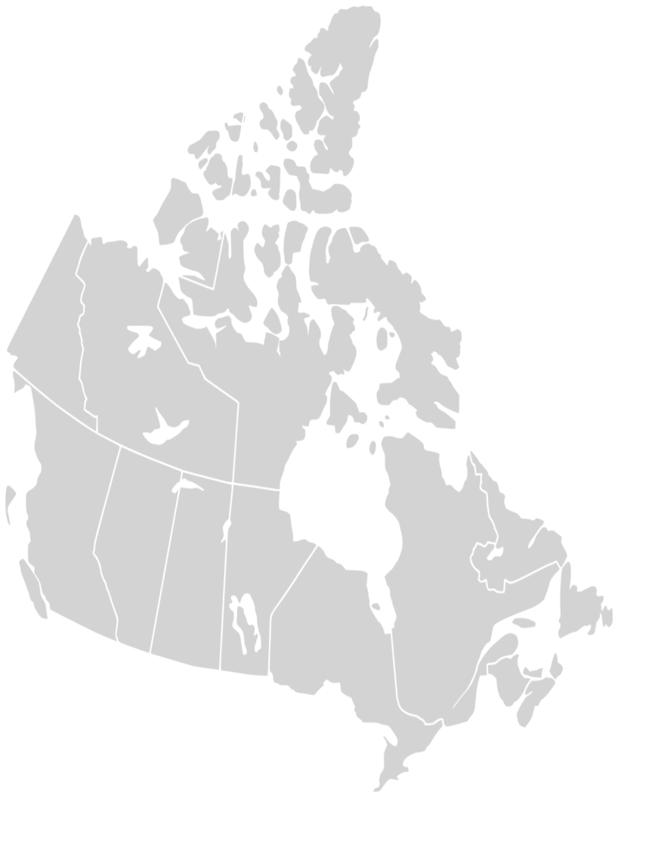
Pan-Canadian Trust Framework: Context
Public Sector
Private Sector/ Industry Initiatives
FPT Clerks and Cabinet Secretaries
FPT Deputy Ministers’ Table on Service Delivery Collaboration
Public Sector Service Delivery Council
Public Sector CIO Council
DIACC* Board of Directors (Includes Public Sector membership)
Joint Councils
Digital Identification Authentication Council of Canada (DIACC)
Immigration Refugee Citizenship Canada / Employment Social Development Canada
IRCC/ESDC
Canada’s Digital Interchange (CDI)
Identity Management Sub Committee (IMSC)
Identity Linkages Project (ILP)
CDI Working Groups
IMSC Working Groups
DIACC Working Groups
Other Initiatives Underway
Death Notification Project
Business Number or Expedited Business Start
DIACC Proof of Concept for Residency
*Digital Identification and Authentication Council of Canada
5

Slide 6
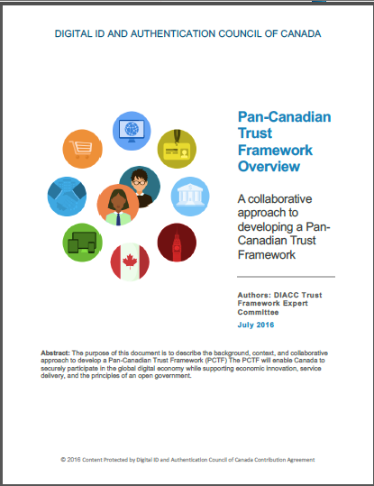
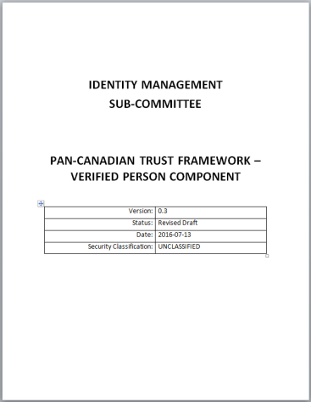
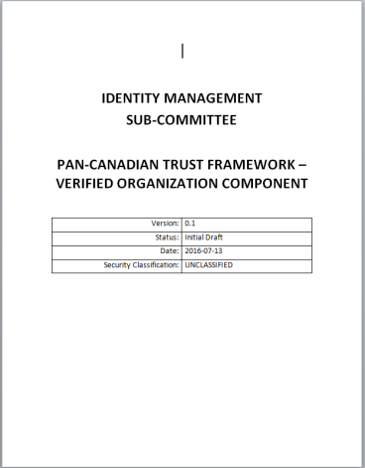
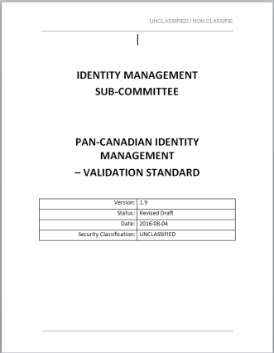
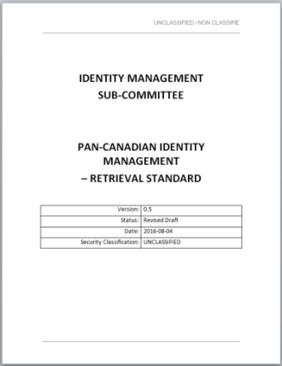
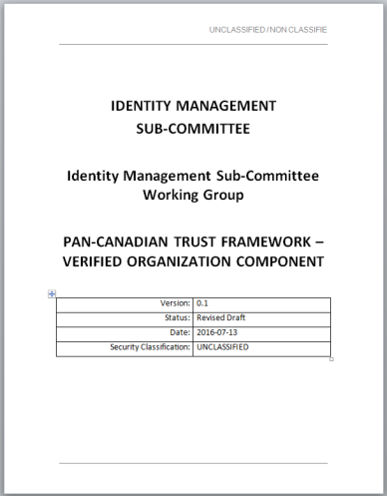
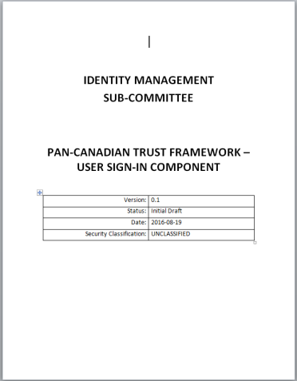
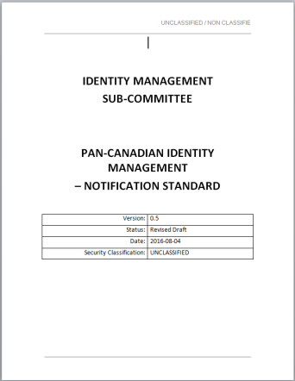
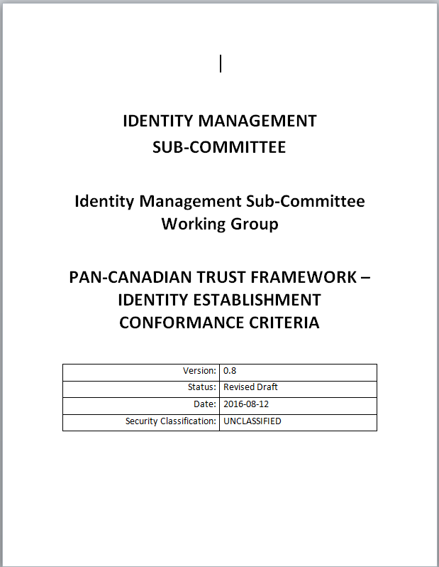
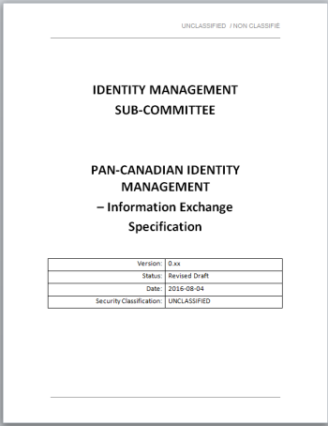
Pan-Canadian Trust Framework Deliverables
Overview and Discussion
Component Overviews and Conformance Criteria
Standards and Specifications
IMSC Discussion Paper:
Digital Identity: Roles and Responsibilities of the Public and Private Sector
Currently the Pan-Canadian Trust Framework suite consists of 11 deliverables:
= published or final drafts
= working group drafts

Slide 7
IMSC Critical Path 2016-2017: Pan Canadian Trust Framework:
IMSC
Jan 2017
Joint Councils
Feb 2017
IMSC
April 2017
FPT DM/Clerks
May 2017
IMSC
Aug 2017
Joint Councils
Sep 2017
FPT DM/ Clerks Nov 2017
Pan-Canadian Trust Framework Approach
COMPLETE
MOUs & Agreements
Letter of Intent
Trusted Identity Definition and Principles
Integrate into TB policy (scheduled for approval)
COMPLETE
OPI
Verified Person Component
Component Overview
Conformance Criteria
Verified Organization / Verified Relationship
Component Overview
Conformance Criteria
Consent and Delegation Component
Component Overview
Conformance Criteria
IMSC Discussion Paper
Roles and Responsibilities the Public and Private Sector
IMSC (TBS)
IMSC (ISED)
TBD
IMSC
Alpha Testing
Validate conformance criteria in operational program context
TBD
Trust Framework Certification
Map against existing processes, specifications and standards.
Define Assessment & Certification Process
NOT STARTED
TBD
Trusted Infrastructure
DIACC Trusted Components
Model Agreements
Contracts
Service Definitions
Role Definitions
DEFERRED
TBD
= update/direction
= decision/endorsement
= updates due to Alpha Testing
= completed
Updated as of January 30, 2017

Slide 8
Trust Framework: Progress on Deliverables
Pan-Canadian Trust Framework | Deliverable(s) | Status | Est. Date | Lead(s)
MOU & Agreements | Letter of Intent | Complete | Apr 2016 | IMSC/DIACC
Trust Framework Overview | Pan-Canadian Trust Framework Overview | Published | Aug 2016 | IMSC/DIACC
User Sign-In Component | User Sign-In Component Overview User Sign-In Conformance Criteria | WG Draft Feedback from Industry Alpha Testing* | May 2017 | DIACC
Verified Person Component | Verified Person Component Overview Verified Person Conformance Criteria | WG Draft Feedback from Jurisdictions Alpha Testing* | May 2017 | IMSC (TBS)
Consent and Delegation Component | Consent and Delegation Overview | Initiation | Fall 2017 | TBD
Verified Organization Component | Verified Organization Component Overview | WG Draft | Nov 2017 | IMSC (ISED)
Verified Relationship Component | Verified Organization Component Overview | Initiated | Nov 2017 | IMSC(ISED)
Standards and Specifications | PCIM Validation Standard PCIM Notification Standard PCIM Retrieval Standard PCIM Information Exchange Specification | Released Versions | Sept 2016 | IMSC
Discussion Paper | Digital Identity: Roles and Responsibilities of the Public and Private Sector | Initiated | April 2017 | IMSC
*Details of Alpha Testing on Next Slide

Slide 9
Alpha Testing of Conformance Criteria
“Alpha Testing”
Involves validation of the conformance criteria in a program or operational context.
Validation includes the following:
Testing, feedback and revisions to conformance criteria as required
Development of guidance to support the interpretation and implementation of the conformance criteria
What does this mean for Business Owners / Program Delivery Managers?
Opportunity to provide tangible and concrete feedback
Develop a common understanding of similar processes carried out in different programs and jurisdictions
Inform the development and practical application of the trust framework
Use as input into service design, digital transformation initiatives.

Slide 10
Risks and Mitigation Discussion
Scope and Complexity
Risk: Trust framework is a complex undertaking (in particular, Consent and Delegation component)
Mitigation: Definition of discrete, manageable deliverables
Resourcing
Risk: Timelines impacted due to absence of dedicated resources and/or funding (based on “best-efforts”)
Mitigation: Dedicated resources and/or additional funding across all jurisdictions
Alignment of Stakeholders
Risk: Diverse community needs need to be aligned (public sector and private sector)
Mitigation: Active collaboration between DIACC and IMSC members (as per LOI)

Slide 11
Proposed Next Steps
Pan-Canadian Trust Framework - Development
Continued development of Pan-Canadian Trust Framework deliverables in IMSC and DIACC working groups
Develop Trust Framework Conformance Criteria and Profiles
Coordinate efforts with other working groups
Canada’s Digital Interchange
Death Registration & Notification
Begin testing of trust framework conformance criteria
‘Alpha Testing’ Program
Initiate Consent and Delegation working group
Reach out to Privacy and Service Delivery communities to lead this work
Pan-Canadian Trust Framework - Implementation
Critical Path Development
Jurisdictional Readiness Assessment
Ongoing Maintenance of Trust Framework products
Continued engagement related to: Information Sharing Agreements (ISAs), Privacy, and Machinery of Government
FPT DM Table (May 2017)
Present progress regarding Pan-Canadian Trust Framework
Seek endorsement on: Verified Person and User-Sign-in components

Slide 12
Annexes

Slide 13
Identity Management
Annex A: Identity Management Priority
Key to improve service and enhance security
Identity is fundamental to Canadian society as it is the starting point of trust and confidence in interactions between the public and governments and government to government
Governments need to know that their clients are who they say they are…
Governments need ways to trust identity information that travels across jurisdictional boundaries
Documents alone cannot provide assurance of identity for digital delivery
Electronic means of validating identity is required for secure online transaction
Need to ensure that identity information remains up to date
Need to provide Canadians with a more streamlined and secure way to interact with governments
All jurisdictions and sectors have a role to play to advance this priority
PTs are the authoritative sources of identity information for persons born in Canada in their respective jurisdictions
The federal government is the authoritative source of identity information of persons born abroad
13

Slide 14

Annex B: Pan-Canadian Trust Framework Components
Letter of Intent
Trusted Digital Identity*
Trusted Access & Authorization
Trustmark
Certification
Verified Person
User Sign-in
Consent and Delegation
Authentication
Service
Authorization
Profiles
Verified Organization
Verified Relationship
Resources
Access
Assessment
Privacy
Security
Audit & Logging
Service Delivery
Organizational
Glossary
14
*Focus of IMSC and DIACC Working Groups
14
*Focus of IMSC and DIACC Working Groups

Slide 15
Annex C: Verified Person Component Example
Selected excerpts from draft deliverable:
Overview
The Verified Person Component defines a set of processes used to verify that an individual is real, identifiable, and truthfully claimed who he or she is. The processes ensure identity information relating to the individual exclusively resolves to the individual only, is confirmed as accurate, is rightfully claimed by the individual (i.e., not being used by an imposter), and is up-to-date.
The Verified Person Component consists of elements that include the following:
Trusted Processes – the set of processes that conform to criteria (conformance criteria) specified by the trust framework and on which may be relied by others
Conditions – the particular states or circumstances relevant to verifying a person
Inputs – into trusted process – an unverified person
Outputs – outputs resulting from trusted processes – a verified person and the qualifier, level of assurance
Dependencies – relationship between trusted processes
Profiles – profiles used to ensure consistency of implementation, specify additional criteria, and facilitate trust framework certification.
Verified Person Trusted Processes
Trusted Process and Conformance Criteria

Slide 16
Annex D: Federating Identity: Milestones and Initiatives 2004-2017
Milestones/Deliverables
2004: Secure Channel, including its epass authentication service, operational
2007: Identity Management & Authentication (IATF) Task Force Report
2008: Cyber Auth Report on Future Requirements for the Government of Canada
2009: TBS Directive on Identity Management
2009: ITSG-31 Authentication Guidance
2010: Pan-Canadian Assurance Model
2010: BC Identity Assurance Standard
2010: BC Evidence of Identity Standard
2010: BC Electronic Credential & Authentication Standard
2010: CIC (Passport Program) Facial Recognition capability operational
2010: Cyber Auth RFP 1/RFP2/RFP3
2011: Federating Identity for the Government of Canada: Backgrounder¹
2011: IMSC Pan-Canadian Approach to Trusting Identities
2011: National Routing System (NRS) Data Exchanges Standard
2012: Cyber Authentication Technical Specification
2012: Guideline on Defining Authentication Requirements
2012: Federating Identity Broker Architecture
2013: GC Federated Credential operational
2013: Standard on Identity and Credential Assurance
2013 Cyber Auth Close Out Report
2013: ePassport operational
2013: Issuing new BC Services Card commenced
2013: Service Quebec now responsible for clicSÉQUR
2013: Ontario approves Electronic Identification, Authentication and Authorization (IAA) policy
2014: Pan-Canadian Identity Validation Standard
2015: GC Guideline on Identity Assurance
2015: BC Identity Information Standard
2016: Pan-Canadian Trust Framework
Initiatives/Oversight
National Routing System
2004-2006: Pilot
2006-Present: In Production
Cyber Authentication Renewal
2008: Creation of DM Cyber Auth Committee
2008-2010: Consultation & Strategy
2010-212: Procurement & Transition
2012: Services Operational: (SecureKey Concierge & GCKey)
2013 Conclusion (DM membership incorporated in DM SFI)
Federating Identity
2010: GC Guideline on Defining Authentication Working Group
2011: GC Guideline on Identity Assurance Working Group
2013: GC Pilot Projects (Individuals/Businesses)
2013: GC Policy & Legal Implications Working Group
2014 Canada’s Digital Interchange
2015 Identity Linkages Project
Task Force for Payments System Review
2012: Recommendation to create Digital Identification and Authentication Task Force (DIAC)
2015: DIACC Trust Framework Working Group
Identity Management Sub-Committee (IMSC)
2012: Changed Reporting Structure to Joint Councils
2013: IMSC Working Group
International
2013-2015: Identity Summits
Involvement in Kantara, ISO & ANSI Standards
DM Committee on Service and Federating Identity (SFI)
2013: Inaugural meeting
Related Arrangements & MOUs
Citizenship Certificate Validation (CIC & Provinces)
Lessons Learned
Strategic Alignment

Slide 17
Annex E: IMSC Members
Federal
Rita Whittle, IMSC Co-Chair
Anik Dupont
Natalie McGee
Caitlin Imrie
Cynthia Leblanc
Daniel McLaughlin
Silvano Tocchi
France Bildodeau
BC
Ian Bailey
Patricia Wiebe
Alberta
Roy Enslev
Jackie Stankey
Saskatchewan
Shaylene Salazar
Wilbour Craddock
Manitoba
Guy Gordon
Patrick Hoger
Ontario
Rob Devries, IMSC Co-Chair
Quebec
Stéphane Auclair
Guy Gagnon
New Brunswick
Colleen Boldon
Nova Scotia
Glen Bishop
Arlene Williams
PEI
Tim Garrity
Newfoundland and Labrador
Susan Wilkins
Yukon
Chris Bookless
Sean McLeish
Northwest Territories
Linda Maljan
Vital Statistics
Valerie Gaston
MSDO/MISA
Karla Hale
Chris Fisher

